Slide 1
10.3 Absorbing Markov Chains
In this section, the concepts of absorbing Markov chains will be discussed and illustrated through examples. We will see that the powers of the transition matrix for an absorbing Markov chain will approach a limiting matrix. We must introduce some terminology first.

Slide 2
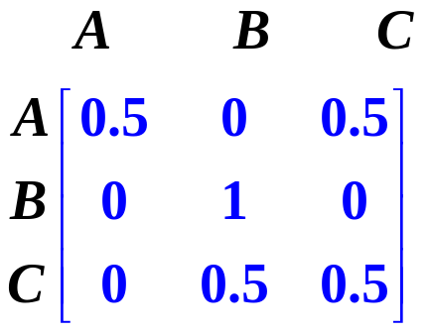
Absorbing state and Absorbing Chains
A state in a Markov chain is called an absorbing state if once the state is entered, it is impossible to leave.
This concept will be illustrated by an example: For the following transition matrix, we determine that B is an absorbing state since the probability from going from state B to state B is one (this means that once the system enters state B it does not leave since the probability of moving from state B to states A or C is zero as indicated by the second row.

Slide 3
Theorem 1:Absorbing states and transition matrices
A state in a Markov chain is absorbing if and only if the row of the transition matrix corresponding to the state has a 1 on the main diagonal and zeros elsewhere.
To ensure that the transition matrices for Markov chains with one or more absorbing states have limiting matrices it is necessary that the chain satisfies the following definition:
A Markov chain is an absorbing chain if:
A) there is at least one absorbing state.
B) It is possible to go from each non-absorbing state to at least one absorbing state in a finite number of steps.

Slide 4
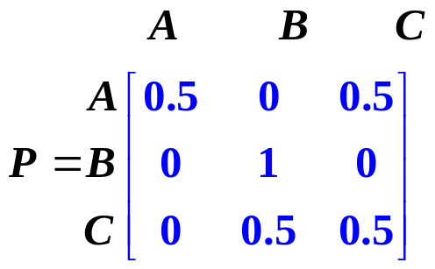
Recognizing Absorbing Markov chains
We will use a transition diagram to determine whether P is the transition matrix for an absorbing Markov chain.

Slide 5
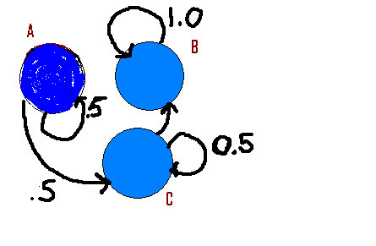
We see that B is an absorbing state

Slide 6
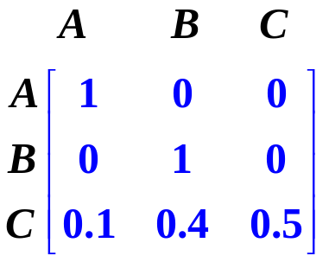
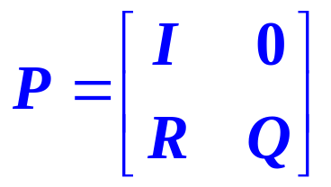
In a transition matrix, if all the absorbing states precede all the non-absorbing states, the matrix is said to be in standard form. Standard forms are very useful in determining limiting matrices for absorbing Markov chains.
The matrix below is in standard form since the absorbing states A and B precede the non-absorbing state C. The general standard form matrix P is listed on the right in which the matrix P is partitioned into four sub-matrices I, O , R and Q where I is an identity matrix and O is the zero matrix.

Slide 7
Limiting Matrix
We are now ready to discuss the long-run behavior of absorbing Markov chains. This will be illustrated with an application.
Two competing real estate companies are trying to buy all the farms in a particular area for future housing development. Each year, 10% of the farmers sell to company A each year, 40% sell to company B and the remainder continue farming. Neither company ever sells any of the farms they purchase.
A) Draw a transition diagram for this Markov process and determine whether the associated Markov chain is absorbing.
B) Write a transition matrix in standard form
C) If neither company owns any farms at the beginning of this competitive buying process, estimate the percentage of farms that each company will purchase in the long run.

Slide 8
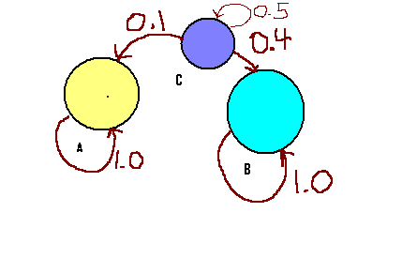
Transition Diagram
We see that states A and B are absorbing. We also see that the associated Markov chain is absorbing, since there are two absorbing states A and B and it is possible to go from the non-absorbing state C to either A or B in one step.

Slide 9
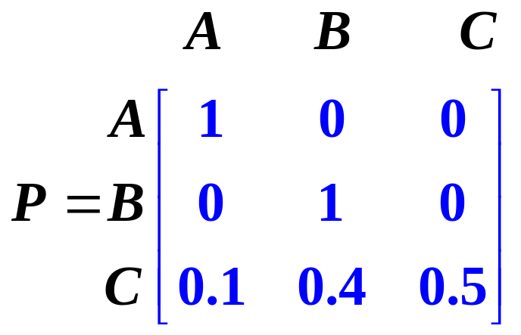
We use the transition diagram to write a transition matrix that is in standard form:
.

Slide 10
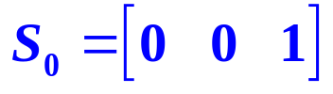
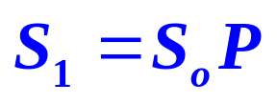

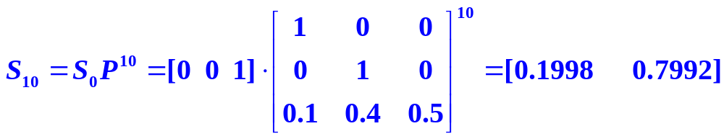
Initial State Matrix; Successive state matrices
At the beginning of this process, all of the farmers are in state C since no land has been sold initially. Therefore, we have the following initial state matrix: The successive state matrices are given as well. Do the state matrices have a limit? To find out, we compute the 10th state matrix and look at the product. We conjecture the limit of the state matrices is
[ 0.2 0.8]
.

Slide 11


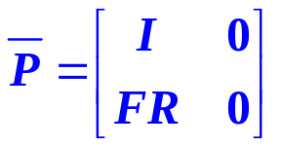

Theorem 2: Limiting Matrices for Absorbing Markov chains
If a standard form P for an absorbing Markov chain is partitioned as
then approaches a limiting matrix as k increases where
The matrix F is given by F =
and is called the fundamental matrix for P
The identity matrix used to form the fundamental matrix F must be the same size as the matrix Q.

Slide 12
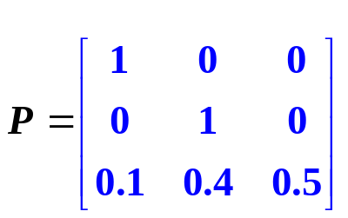
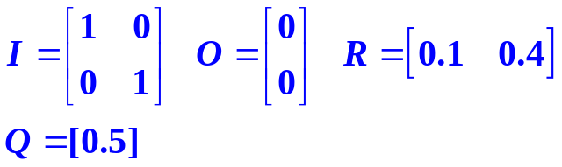
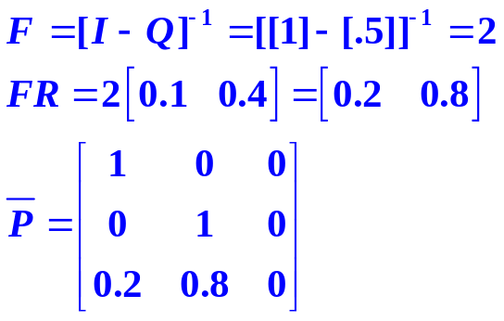
Using the Formulas to find the limiting matrix
We identify the display the appropriate matrices:
Use the formula to find the matrix F. Q is a 1x1 matrix.
Next, determine FR
Display the limiting matrix. Notice that the last row is the same the kth state matrix.
.

